Slide 1
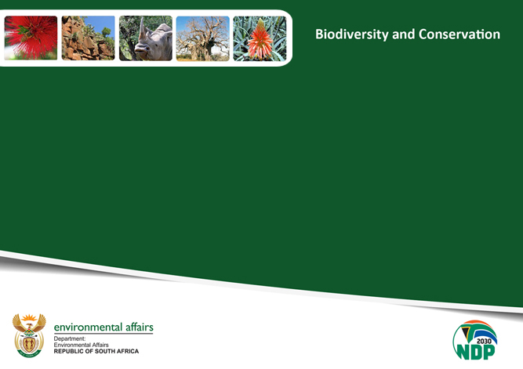
:
TOWARDS A TRANSFORMED, INCLUSIVE AND SUSTAINABLE BIODIVERSITY ECONOMY SECTOR FOR ALL

Slide 2

Mandate
The Department of Environmental Affairs draws its Mandate from Section 24 of the South African Constitution which protects the environment for the present and future generations through measures that conserve, protect and advance the sustainable utilization of South Africa’s Terrestrial and Marine Biodiversity; regulation of environmental impacts on soil, water & air; and the promotion and encouragement of sustainable Development through various mechanisms including advocacy.

Slide 3
Vision
A prosperous and equitable society living in harmony with its natural resources.

Slide 4
Mission
Inspired by its conviction to transform the environmental sector within the context of a developmental state – which focuses on facilitating and supporting the planning and sustainable growth of economic activity in green sectors,
DEA’s mission is to provide leadership in environmental management, conservation and protection towards sustainability for the benefit of South Africans and the global community

Slide 5

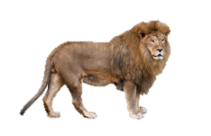
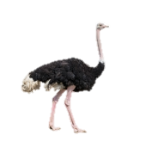



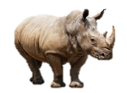

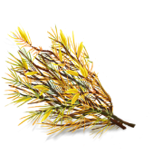





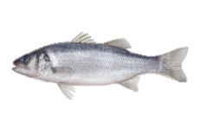
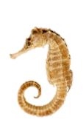
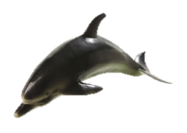

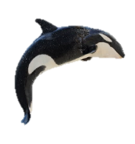
South Africa is the 3rd most biodiverse country in the world
  7% of the world’s reptiles, birds and mammals
  10% of the
  world’s plants
  South Africa
  2% of the
  world’s land area
  15% of the world’s coastal marine species

Slide 6
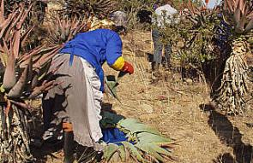
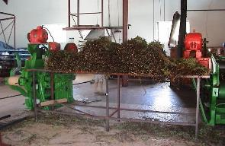
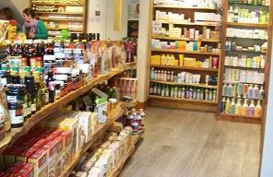
Bioprospecting sector overview
CONTEXT
Revenue
Resources
Processing and trade
Final domestic products
R 0.26 b
R 0.92 b
R 2.08 b
  Both wild harvesters and farmers supply the sector
  The market is largely focused on plant resources
  Primarily trade in indigenous plant species, of which 70% are exported as raw materials
  Operate in two categories
    Trade of raw and semi-processed materials
    Development and sale of intermediary products
  Development and sale of final value added products
  The trend towards “natural” products demand is high and customers pay a price premium for goods with indigenous resources

Slide 7
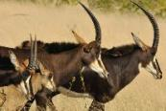
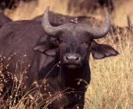
The Wildlife sector has been growing consistently faster than the general economy, contributing R 3 billion to GDP in 2014
Wildlife GDP contribution, R billions
2.88
3.01
2.61
2.35
2.11
1.87
1.66
2008
2009
2010
2011
2012
2013
2014
Wildlife Sector Growth p.a.
9.2%
13.5%
9.9%
9.3%
4.5%
9.3%
General GDP Growth p.a.
-1.54%
3.04%
3.21%
2.22%
2.21%
1.52%
SOURCE: National Biodiversity Economy Strategy & Stats SA

Slide 8
NBES Targets aligned to Phakisa
 |  | BIOPROSPECTING SECTOR | WILDLIFE SECTOR
Aspirations |  | To develop and improve the bioprospecting industry to create a sustainable, inclusive and commercially viable sector adding 10 000 new jobs and contributing R1.7 billion to GDP at 10% p.a. by 2030 | An inclusive, sustainable and responsive wildlife economy that grows at 10% p.a until at least 2030, while providing a foundation for social well-being and maintaining the ecological resource base
Objectives | Economic growth | GDP contribution growth from R309 million in 2013 to R1.7 billion in 2030 Grow from 6 200 to 16 200 permanent jobs | Average yearly sector GDP increase of ~10% Create 100,000 new jobs
 | Transformation | 30-50% of South African bioprospecting products must have community involvement in the supply chain Product development in the informal sector by focusing on TK holders, communities and members of the informal market Diversify the market by promoting enterprise development and increasing accessible funding for new entrants | 30% of wildlife businesses PDI owned PDI ownership of >5 million Ha, and access to another >5 million ha 4,000 PDI owned SMMEs supported to engage in the wildlife economy
 | Sustainability | Grow cultivation of natural ingredients by at least 500 ha p.a | 5 Million ha of non-protected areas contributing towards conservation target (aichi) 3.5% animal population net growth p.a.

Slide 9
Biodiversity Economy sectoral challenges
The sector is also fully reflective of the general land ownership patterns in South Africa which is skewed towards one racial group.
Lack of access to ‘startup’ game, requisite infrastructure development support and access to finance and incentives for transformation
Internal governance conflicts amongst community members
The long and tedious turn-around times for issuing BABS permits
Little value attached to genetic resources and thus vulnerable to exploitation
Market intelligence and accessibility challenges
Excessive and inefficient permitting systems.

Slide 10
ADDRESSING THE CHALLENGES

Slide 11
The Wildlife Economy Lab developed detailed plans for
15 initiatives and 6 additional initiatives
INITIATIVES
Recommendations¹
Driving growth through promoting ‘value’ and products
Creating an enabling environment for the wildlife sector
Facilitating transformation
1
Identify and prioritise 10m Ha for transformation of wildlife economy
7
Formalise SA game meat market and create a network of game meat processing facilities
9
Create an enabling legislative environment through the amendment of NEMBA
2
Coordinate existing support mechanisms under a ‘Wildlife Support Unit’ to efficiently support new entrants to the industry
8
Implement a campaign that drives participative transformation and consumer growth for wildlife-related activities and products
10
Develop and implement wildlife industry standards
3
Increase capacity and support for at least 300 Community Entities including community property agreements (CPAs), trusts and traditional authorities
11
Implement a national wildlife economy branding scheme
ii
Promote sustainable use as a foundation for conservation and growth of biodiversity economy
12
Develop and implement an electronic wildlife permitting system and centralised database
4
Create supply-chain linkages and capacitate 4,000 SMMEs (new and existing) to locally capture the value of ancillary goods and services to the wildlife economy
iii
Develop a strategic marketing campaign and value proposition for mixed game and livestock systems
13
“Re-position” the Wildlife Forum as an efficient interdepartmental/ industry collaboration and co-ordination platform to promote the benefits of the Wildlife Economy
5
Operationalise the uMfolozi Biodiversity Economy Node as a pilot for the wildlife node concept
iv
Establish mechanisms to allow for holistic and integrated management of animal health and conflict issues at the livestock-wildlife interface
14
Develop an integrated knowledge/
evidence generating and sharing platform to support the wildlife economy
6
Empower 4,000 emerging entrepreneurs and farmers through focused capacity-building programmes
v
Fast track the development of norms and standards to actively manage and mitigate critical wildlife economy risks such as intensive and selective breeding, animal diseases and invasive species
15
Leverage protected areas to unlock economic potential
i
Develop a toolkit of effective wildlife business, stewardship and partnership models
vi
Develop, upskill and resource extension services to facilitate the growth of the wildlife economy
1 Recommendations will be included with high level activities, but these will not have 3ft plans

Slide 12




Key initiatives to drive growth in the Bioprospecting Economy
How do we increase the supply?
How do we increase demand and local value addition?
  Promote a mass cultivation
  drive of 25 plant species of strategic importance and
  increase cultivation by
  500 hectares per annum
  Establish a coordinating and facilitating BioPANZA (Bio Products Advancement Network South Africa) to harness existing initiatives and to address the innovation chasm
  Promote applied research, local processing, innovation and
  product development; and to promote the use and awareness
  of products with IBRs
1
3
  Define management plans to ensure sustainable wild harvesting of 7 high value plant species to safeguard long term supply
2
Regulatory
Fast tracking amendments of Chapter 6 of National Environmental Management Biodiversity Act (NEM:BA) to ease compliance while ensuring protection of the rights and benefits of traditional knowledge (TK) holders and alignment with Nagoya Protocol on Access and Benefit Sharing
4
5
Improve efficiencies in the Bioprospecting Access and Benefit Sharing (BABS) permitting system
Transformation is a cross cutting essential

Slide 13
Government intervention
Nemba Bill amendment
Phakisa initiatives (Biodiversity, Ocean, Waste Phakisa etc)
The Biodiversity Economy Strategy
Biodiversity Economy Indaba to create a marketing platform for biodiversity and genetic resources
Biodiversity Transformation Charter Council
Game donation to PDIs and communities
Infrastructure support
Transaction advisors to support emerging entrepreneurs
Biopanza to create a network of bioprospecting and biotrading institutions to coordinate their activities to avoid duplications of efforts and close sectoral gaps for efficiency.
Address issues of food security, job creation and economic prosperity through game meat processing, skin and hides industry etc

Slide 14
Industry role
The Industry must transform
Must invest in the African majority
Localise the industry where genetic resources naturally occur
Must skill the emerging farmers
Give new entrants access to market
Handhold the new enterprise
Must embrace the Transformation initiatives
Must donate game to new and emerging farmers
“Adopt an emerging farmer” approach.
“Prosperity for all attitude”

Slide 15
Local Communities
CPAs and Traditional Councils should stop fighting but instead ensure optimal production of the land
CPAs and Traditional Councils to focus on governance issues and allow entrepreneurs amongst themselves to do business
Diversify their land for a whole range of business opportunities (game breeding, wildlife estates, lodges, game viewing etc.)
Dedicate their children for business skills training.

Slide 16
BIODIVERSITY ECONOMY INDABA (BEI)
To pitch the BEI as a Premier African Biodiversity Economy Trade and Investment platform,
To stage the BEI as a unique platform to match the lucrative international wildlife and bioprospecting/biotrade markets with owners, custodians and stock holders of wildlife and genetic resources in South Africa and Africa-(bringing the market to Africa!)
To optimize the BEI as a platform to accelerate inclusive growth, transformation and sustainable development within the wildlife and bioprospecting/trade sector
Catalyst for accelerating the economy of the town/city area where it is hosted.
To utilise BEI as a platform for regional dialogue/negotiations and cooperation on biodiversity economy and management issues and crafting the regional position on such issues
To create awareness of wildlife and bioprospecting/trade beneficiation through conservation and localization of industries
To host the BEI as an annual event, incorporating aspects exhibitions, dialogue/conference, trade and investment and launching pad for new initiatives within the biodiversity economy sector
Possibility of finding a permeant home for the BEI, pull resources for it and brand it

Slide 17
POLICY OBJECTIVES FOR NEMBA CHAPTER 6 AMENDMENT
1) To redress the injustice of the past in order to achieve socio-economic development goals ~ fair & equitable benefits sharing.
2)To provide regulatory framework for bioprospecting / biotrade activities ~ attain conservation & sustainable utilization of Indigenous Biological Resources ~ Permitting System.
3)To provide obligatory requirements to the regulated sectors to recognize existing Traditional Knowledge on the useful properties of Indigenous Biological Resources ~ Benefit Sharing Agreements.
5) To implement international regulatory obligations adopted by South Africa ~ CBD & Nagoya Protocol on ABS
4)To provide obligatory requirements to the regulated sectors to seek permission from the land owners to access/collect Indigenous Biological Resources ~ Material Transfer Agreements & Benefit Sharing Agreements.

Slide 18
www.thegamechanger.co.za

Slide 19
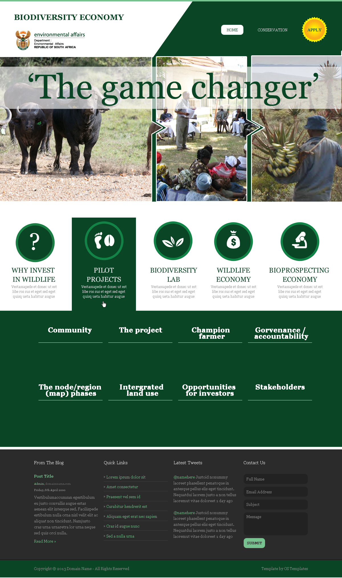

Slide 20
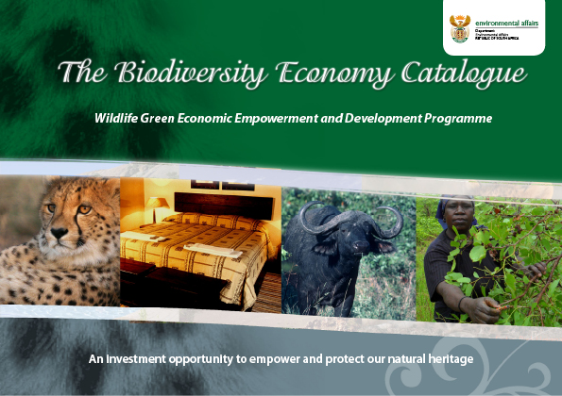

Slide 21

Mr Khorommbi Matibe
Chief Director: Biodiversity Economy & Sustainable Use
Department of Environmental Affairs
012 399 8621/082 566 4257
kmatibe@environment.gov.za

